Slide 1
Bootcamp 2020
Session 02: Advanced Docker Lessons

Slide 2
Basic Docker CLI
How to launch containers
How Docker images work
Configuration using environment variables
Networking and Persistence
Docker Compose
Session 01 review

Slide 3
How to create Docker Images: creating Dockerfiles
Become a “pro” building containers: Dockerfile Best Practices
Initializing your apps: Bash Containers
Lunch
Exercises

Slide 4
How to create Docker Images: creating Dockerfile

Slide 5

The Dockerfile
The proper way to create Docker images is by writing a Dockerfile.
A Dockerfile contains a list of instructions that will be executed in order to build the image.
Each instruction will create a new layer.
Instructions are cached. If no changes are detected, the instruction is skipped and the cached layer used.

Slide 6
Basic Structure
FROM bitnami/minideb:latest LABEL maintainer "Me juanariza@mvware.com" LABEL ... COPY ... ADD ... RUN ... ENV ... EXPOSE ... USER ... WORKDIR ... ENTRYPOINT ... CMD ...
Base container image
Basic metadata
Build instructions
Usage data: environment variables, exposed ports, user, etc.
Startup commands

Slide 7
Dockerfile
Base container image
FROM instruction:
Specifies the source image to build this image.
Possible to specify the empty image "scratch" (useful for containers with single binaries).
Can be used multiple times in a Dockerfile (multi-stage build)
Basic syntax:
FROM <image>

Slide 8
Dockerfile
Basic metadata
LABEL instruction:
Adds metadata to the image.
Labels included in base images are inherited.
Recommendations in this link.
Basic syntax:
LABEL <key>=<value> <key>=<value> <key>=<value> …

Slide 9
Dockerfile
Build instructions
COPY instruction:
Copies new files or directories from the host system and adds them to the container’s filesystem.
The files must be in the same context as the Dockerfiles (i.e. same folder).
Basic syntax:
COPY [--chown=<user>=<group>] <src>… <dest>
ADD instruction:
Similar to COPY instruction with extra features (e.g. allow URLs, extract tarballs).
Basic syntax:
ADD [--chown=<user>=<group>] <src>… <dest>
RUN instruction:
Executes a command in a new layer.
Basic syntax:
RUN <command>
RUN [”executable”, “param1”, “param2”]

Slide 10
Dockerfile
Usage data
ENV instruction:
Sets an environment variable inside the container (can be used on subsequent RUN commands).
Basic syntax:
ENV <key>=<value>
EXPOSE instruction:
Tells Docker the container listens on the specified network ports at runtime.
Basic syntax:
EXPOSE <port>

Slide 11
Dockerfile
Usage data (ii)
USER instruction:
Sets the user name (or UID) and optionally the user group (or GID) to use when running the image.
Also for any subsequent RUN, CMD and ENTRYPOINT instructions.
Basic syntax:
USER <user>[:<group>]
USER <UID>[:<GID>]
WORKDIR instruction:
Sets the working directory for any RUN, CMD, ENTRYPOINT, COPY and ADD instructions that follow it in the Dockerfile.
If a relative path is provided, it will be relative to the path of the previous WORKDIR instruction.
Basic syntax:
WORKDIR /path/to/workdir

Slide 12
Dockerfile
Startup commands
ENTRYPOINT instruction:
Sets default executable that will run when launching a container.
Basic syntax:
ENTRYPOINT <command>
ENTRYPOINT [”executable”, “param1”, “param2”]
Examples:
ENTRYPOINT [“nginx”]
docker run -ti my_nginx nginx
docker run -ti my_nginx -c /etc/nginx.conf nginx -c /etc/nginx.conf
docker run -ti my_nginx bash nginx bash
ENTRYPOINT “nginx”
docker run -ti my_nginx /bin/sh -c nginx
docker run -ti my_nginx -c /etc/nginx.conf /bin/sh -c nginx –c /etc/nginx.conf
docker run -ti my_nginx bash /bin/sh -c nginx bash

Slide 13
Dockerfile
Startup commands (ii)
CMD instruction:
Provides default parameters to an entrypoint.
If no entrypoint is defined, the CMD will be used as starting command.
Basic syntax:
CMD param1 param2
CMD [”param1”, “param2”]
Examples:
ENTRYPOINT [“nginx”]
CMD [“-c” “/etc/nginx.conf”]
docker run -ti my_nginx nginx -c /etc/nginx.conf
docker run -ti my_nginx -c /tmp/a.conf nginx -c /tmp/a.conf
docker run -ti my_nginx bash nginx bash

Slide 14
Dockerfile
Enough instructions! I want to build
Basic command for building an image:
$ docker build -t <image name> <context folder>
It will try to find a Dockerfile in this path
Example:
$ docker build -t my/test:latest . $ docker run --rm -p 8080:80 my/test:latest

Slide 15
Dockerfile
Enough instructions! I want to build (ii)
Let’s build something
FROM bitnami/minideb:latest LABEL maintainer "Palmerin palmerin@realbetisbalompie.es" RUN apt-get update RUN apt-get install -y nginx COPY index.html /var/www/html EXPOSE 80 WORKDIR /var/www/html ENTRYPOINT ["nginx"] CMD ["-c“, "/etc/nginx/nginx.conf“, "-g“, "daemon off;"]
<html> <header> <title>Palmerin website</title> </header> <body> Viva el Betis </body> </html>

Slide 16
Dockerfile best practices

Slide 17
Resources:
https://github.com/juan131/dockerfile-best-practices
https://github.com/juan131/bash-libraries

Slide 18
We just wanna say, we're a big fan of your work. When it comes to killing Nazis, I think you show great talent, and I pride myself on having a eye for that kind of talent. But your status as a Nazi killer, is still amateur. We all came here to see, if you wanna go pro?
Lt. Aldo Raine - Inglorious Bastards

Slide 19
Dockerfile Best Practices
Concepts to refresh
What is a Docker layer?
Each layer in a Docker context represents an instruction included in a Docker image’s Dockerfile. They can also be referred as a “build steps”.
What is the Docker Build Cache?
Everytime that you build a Docker image, each build step is cached. You can reuse cached layers that do not change in the image rebuild process to improve the build time.
FROM bitnami/minideb:latest LABEL maintainer "Bitnami <containers@bitnami.com>" # Install required system packages and dependencies RUN install_packages build-essential ca-certificates curl ... RUN curl -Lo ... ENV PATH="/opt/bitnami/php/bin:$PATH" \ ... EXPOSE 8080 ...

Slide 20




Dockerfile Best Practices
What should you worry about when building images?
Consistency
Be consistent designing your images to speed up development. Easier to maintain.
Build Time
Reducing the build time can reduce significantly your apps' development cost.
Image size
By reducing the size, you improve the security, performance, and efficiency of your containers.
Security
Critical for production environments. Protect your applications from external threats and attacks.

Slide 21
Dockerfile Best Practices
Before we start...
A couple of advices:
Enable Buildkit: It will improve the performance when building Docker images.
Install a Linter for Dockerfiles on your editor / IDE: It will help you to identify common pitfalls and syntax errors when developing Dockerfiles.

Slide 22
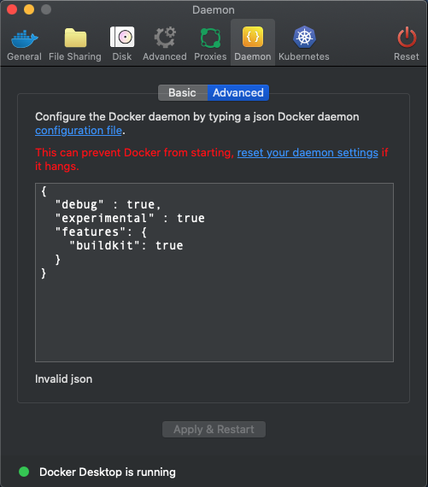
Dockerfile Best Practices
Buildkit
Enable Buildkit
BuildKit can be enabled on two different ways:
Exporting the DOCKER_BUILDKIT environment variable:
Buildkit is a toolkit, which is part of the Moby project, that will improve the performance when building Docker images
GitHub link: https://github.com/moby/buildkit
export DOCKER_BUILDKIT=1
Configuring the Docker Daemon to add the Buildkit feature:
Linux Systems (edit /etc/docker/daemon.json)
On MacOS go to the whale in the taskbar > Preferences > Daemon > Advanced

Slide 23
Dockerfile Best Practices
Linter
Install a Linter for Dockerfiles on your editor / IDE
(Wikipedia) A linter is a tool that analyzes source code to flag programming errors, bugs, stylistic errors, and suspicious constructs.
You can find linters for Dockerfiles on almost every IDE.
Dockerfile linters for popular IDEs:
Atom: https://github.com/AtomLinter/linter-docker
Eclipse: https://marketplace.eclipse.org/content/docker-editor
Visual studio: https://marketplace.visualstudio.com/items?itemName=henriiik.docker-linter

Slide 24
A real example
Improving a Node.js app Docker image
A journey from a very basic Dockerfile to make it production-ready:
Take advantage of the build cache.
Avoid packaging dependencies that you do not need.
Use minideb.
Reuse maintained images when posible.
Use multi-stage builds to separate build and runtime environments.
Use the non-root approach to enforce the container security
Set the WORKDIR instruction.
Mount the application configuration and use the VOLUME instruction.
Redirect the application logs to the stdout/stderr.
Define an entrypoint.

Slide 25

Dockerfile Best Practices
A real example: Improving a Node.js app Docker image
'use strict'; const express = require('express'); const fs = require('fs'); const myLogFileStream = fs.createWriteStream('/var/log/app.log'); const myConsole = new console.Console(myLogFileStream, myLogFileStream); // Constants const serverHost = '127.0.0.1'; const serverPort = 80; // Express app const app = express(); app.get('/', (req, res) => { res.send('Hello world\n'); }); app.listen(serverPort); myConsole.log(`Running on http://${serverHost}:${serverPort}`);
{ "name": "express_example", "version": "1.0.0", "description": "Express App Example", "author": "Juan Ariza <juanariza@vmware.com>", "main": "server.js", "engines": { "node": ">=10" }, "scripts": { "start": "node server.js" }, "dependencies": { "express": "^4.17.1" } }

Slide 26
Dockerfile Best Practices
A real example: Improving a Node.js app Docker image
FROM debian
# Copy application files COPY . /app
# Install required system packages RUN apt-get update RUN apt-get -y install imagemagick curl software-properties-common gnupg vim ssh RUN curl -sL https://deb.nodesource.com/setup_10.x | bash - RUN apt-get -y install nodejs
# Install NPM dependencies RUN npm install --prefix /app EXPOSE 80 CMD ["npm", "start", "--prefix", "app"]

Slide 27
Dockerfile Best Practices
A real example: Improving a Node.js app Docker image
Let’s build the docker image and run it:
$ docker build . -t express-image:0.0.1 [+] Building 129.2s (12/12) FINISHED => [internal] load build definition from Dockerfile 0.1s => => transferring dockerfile: 425B 0.0s => [internal] load .dockerignore 0.1s => => transferring context: 2B 0.0s => [internal] load metadata for docker.io/library/debian:latest 3.1s => [internal] load build context 0.6s => => transferring context: 153.42kB 0.5s => [1/7] FROM docker.io/library/debian@sha256:... 15.7s => => resolve docker.io/library/debian@sha256:... 0.0s => => sha256:… 529B / 529B 0.0s => => sha256:… 1.50kB / 1.50kB 0.0s => => sha256:… 50.38MB / 50.38MB 7.4s => => sha256:… 1.64kB / 1.64kB 0.0s => => extracting sha256:… 7.5s => [2/7] COPY . /app 0.1s => [3/7] RUN apt-get update 8.6s => [4/7] RUN apt-get -y install imagemagick curl software-properties-common gnupg vim ssh 62.7s => [5/7] RUN curl -sL https://deb.nodesource.com/setup_10.x | bash - 12.9s => [6/7] RUN apt-get -y install nodejs 15.1s => [7/7] RUN npm install --prefix /app 0.1s => exporting to image 0.6s => => exporting layers 10.6s => => writing image sha256:… 0.0s => => naming to docker.io/library/express-image:0.0.1 0.0s $ docker run --it -p 8080:80 express-image:0.0.1
It took 129.2 seconds to be built!
Open a browser and go to http://127.0.0.1:8080

Slide 28
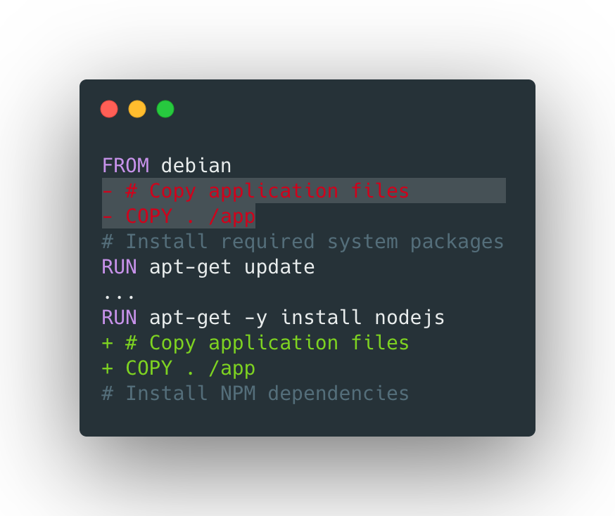
Dockerfile Best Practices
Taking advantage of the build cache (i)
A real example: Improving a Node.js app Docker image
Edit the message used in the console.log at server.js and rebuild the image:
Build cache is based on the previous steps and you should always have it in mind to reduce the build time by reusing existing layers.
Let’s emulate the process of rebuilding your apps’ image to introduce a new change in the code so you can understand how the cache work...
$ sed -ie 's/Running on/Website available at/g' server.js $ docker build . -t express-image:0.0.2 [+] Building 115.5s (12/12) FINISHED
Switch the order of the layers so you will be able to avoid reinstalling the system packages and repeat the process:
$ sed -ie 's/Running on/Website available at/g' server.js $ docker build . -t express-image:0.0.2 [+] Building 11.8 (12/12) FINISHED

Slide 29
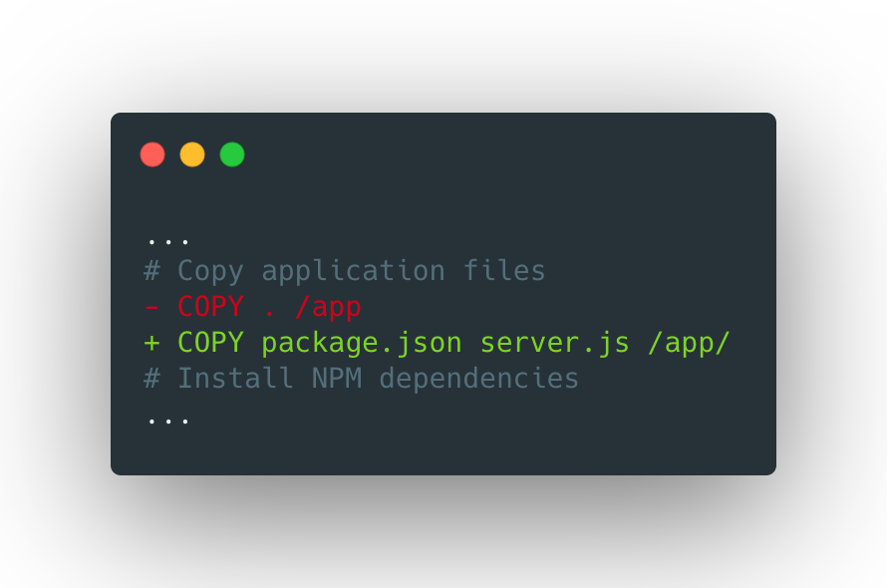
Dockerfile Best Practices
Taking advantage of the build cache (ii)
A real example: Improving a Node.js app Docker image
What would happen if a single character changes in the README.md file (or any other file which is the repository but it's not related with the application)?
Build cache is based on the previous steps and you should always have it in mind to reduce the build time by reusing existing layers.
Let’s emulate the process of rebuilding your apps’ image to introduce a new change in the code so you can understand how the cache work...
Be more specific about the files you copy to make sure that you are not invalidating the cache.
Note: Use COPY instead of ADD when possible. Both commands do basically the same but ADD is much more complex (it has extra features like extracting files or copying them from remote sources).

Slide 30
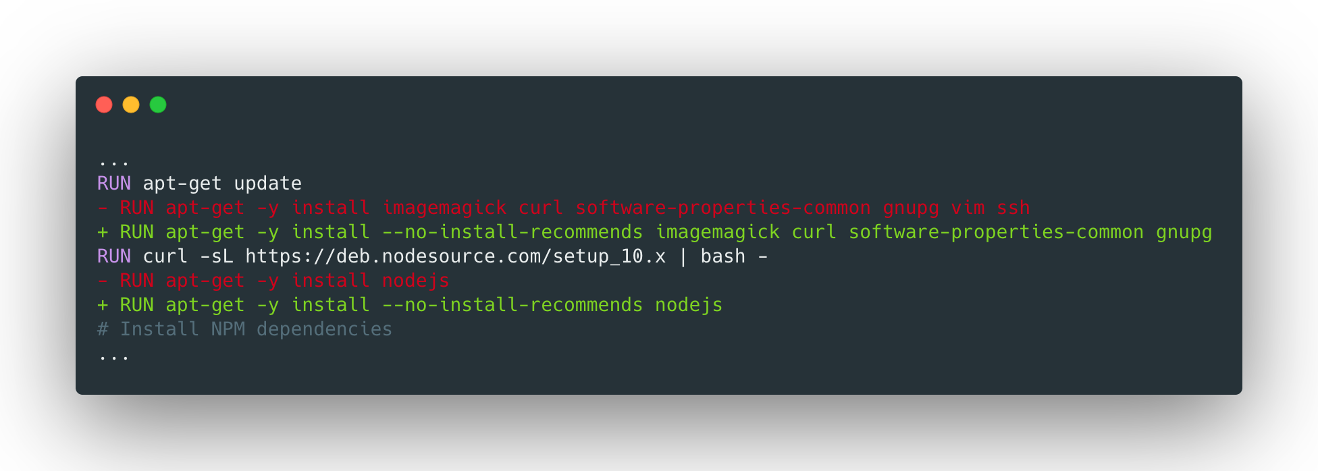
Dockerfile Best Practices
Avoid dependencies that you don’t need (i)
A real example: Improving a Node.js app Docker image
Currently you are shipping unnecessary system packages such as:
ssh: you can access your containers using the `docker exec` command instead of SSH’ing into them.
vim: used for debugging purposes. We can install it when required instead of packaging it by default. You can remove both packages from the image
When building containers to run them in production, every unused package, or those included for debugging purposes, should be removed.

Slide 31
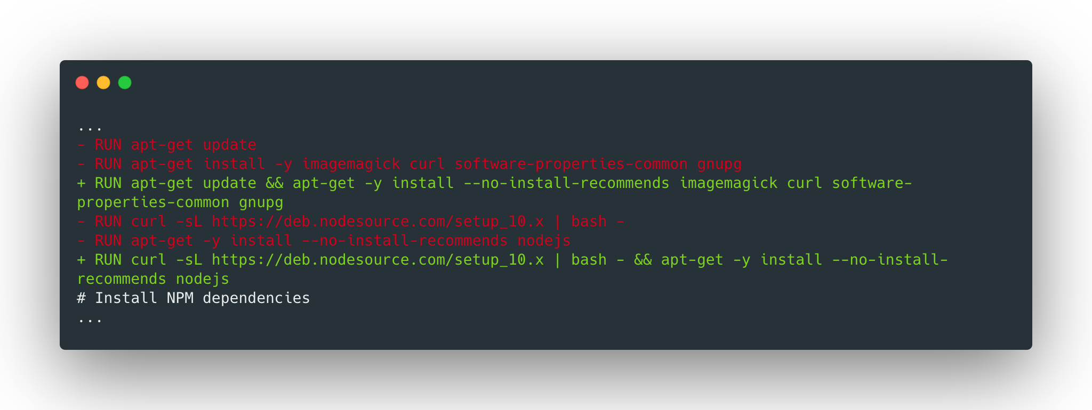
Dockerfile Best Practices
Avoid dependencies that you don’t need (ii)
A real example: Improving a Node.js app Docker image
Does it make sense to use different build steps to update/install system packages? What happens if I add a new package to the list?
When building containers to run them in production, every unused package, or those included for debugging purposes, should be removed.
You could install outdated packages when rebuilding the image.
Let's merge them on a single layer!

Slide 32
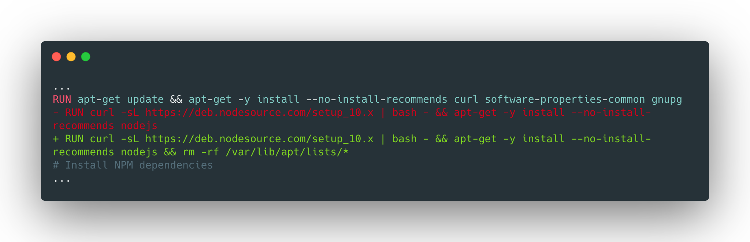
Dockerfile Best Practices
Avoid dependencies that you don’t need (iii)
A real example: Improving a Node.js app Docker image
Trick: remove the package manager cache to reduce the image size:
When building containers to run them in production, every unused package, or those included for debugging purposes, should be removed.
Let’s rebuild the image after these improvements and compared the size...
$ docker build . -t express-image:0.0.3 $ docker images --format "{{.Repository}}{{.Tag}} {{.Size}}" express-image0.0.3 383MB express-image0.0.2 561MB express-image0.0.1 561MB
You saved 178 MB!!!

Slide 33
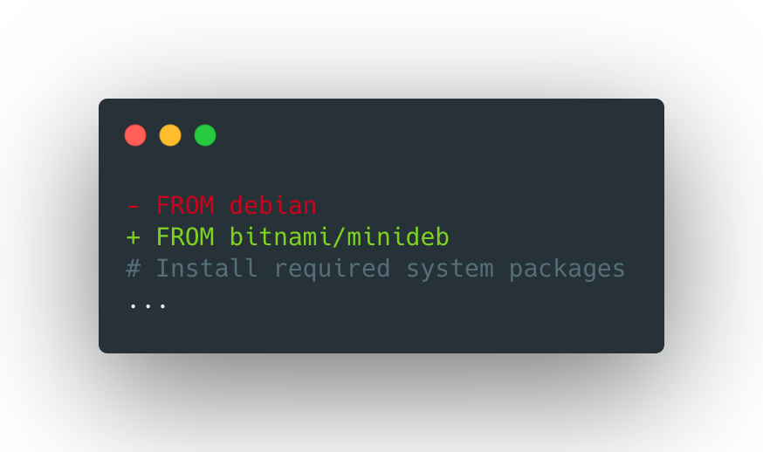
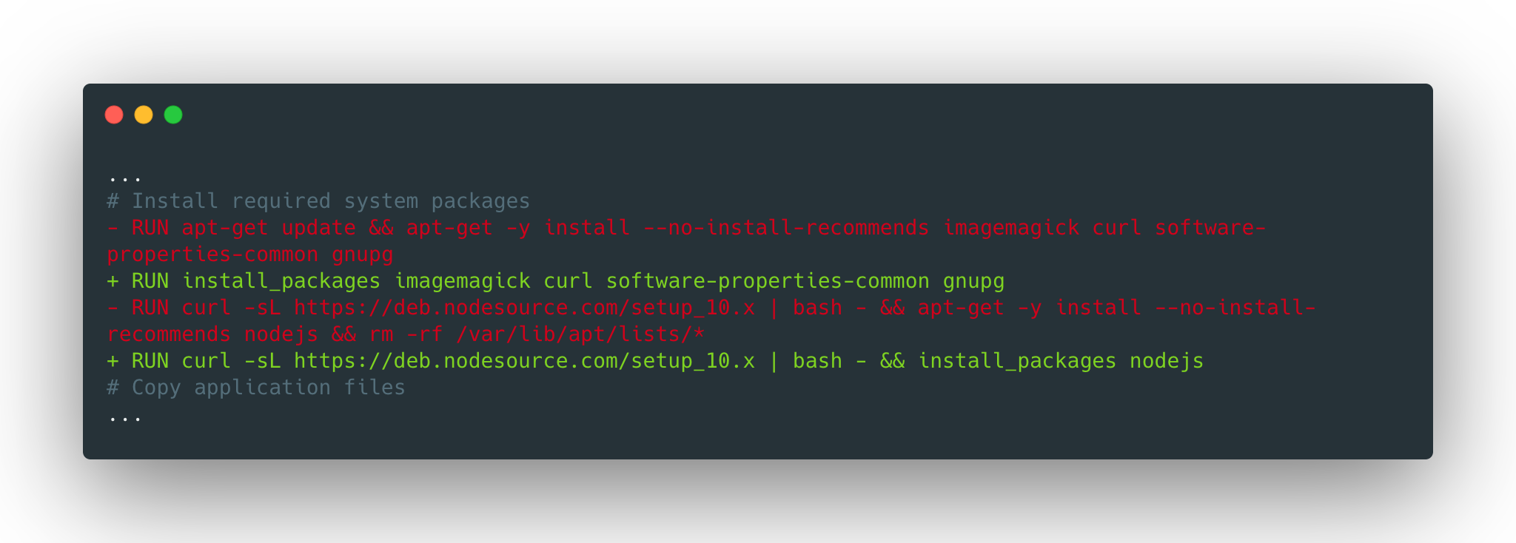
Dockerfile Best Practices
Use minideb (i)
A real example: Improving a Node.js app Docker image
Use Minideb as the base image:
Minideb is a minimalist Debian-based image built specifically to be used as a base image for containers. You can reduce the image size significantly using it as the base image.
Minideb includes a command called `install_packages` that takes care of some things for us such as:
Installing the named packages, skipping prompts etc.
Cleaning up the apt metadata afterwards to keep the image small.
Retrying the build if the `apt-get` instructions fail.
Replace the `apt-get` instructions with `install_packages`:

Slide 34
Dockerfile Best Practices
Use minideb (ii)
A real example: Improving a Node.js app Docker image
Let’s rebuild the image after these improvements and compared the size...
Minideb is a minimalist Debian-based image built specifically to be used as a base image for containers. You can reduce the image size significantly using it as the base image.
Minideb includes a command called `install_packages` that takes care of some things for us such as:
Installing the named packages, skipping prompts etc.
Cleaning up the apt metadata afterwards to keep the image small.
Retrying the build if the `apt-get` instructions fail.
$ docker build . -t express-image:0.0.4 $ docker images --format "{{.Repository}}{{.Tag}} {{.Size}}" express-image0.0.4 319MB express-image0.0.3 383MB …
You saved another 64 MB!!!

Slide 35
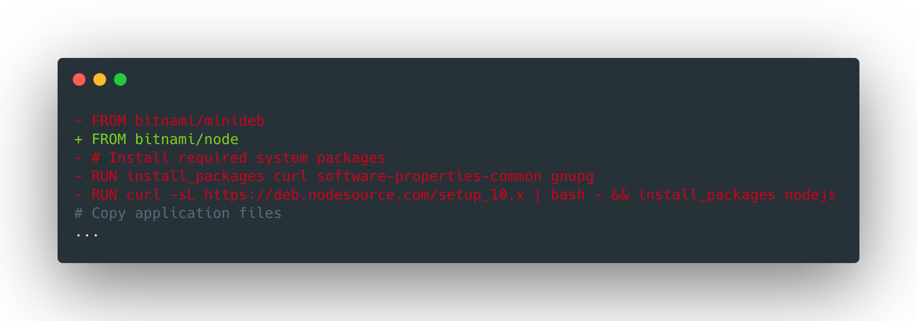
Dockerfile Best Practices
Reuse maintained images when possible (i)
A real example: Improving a Node.js app Docker image
Use the bitnami/node image instead of installing the system packages we need to run Node:
Using images maintained by Bitnami gives you some benefits:
Reducing the size by sharing layers between images.
Tracking base images’ vulnerabilities on Quay by consulting the scan results
Ensuring all the components are packaged with the latest available patches since they are rebuilt every day.
Let’s rebuild the image again...
$ docker build . -t express-image:0.0.5 $ docker images --format "{{.Repository}}{{.Tag}} {{.Size}}" express-image0.0.5 561MB express-image0.0.4 319MB …
Hmm…??

Slide 36
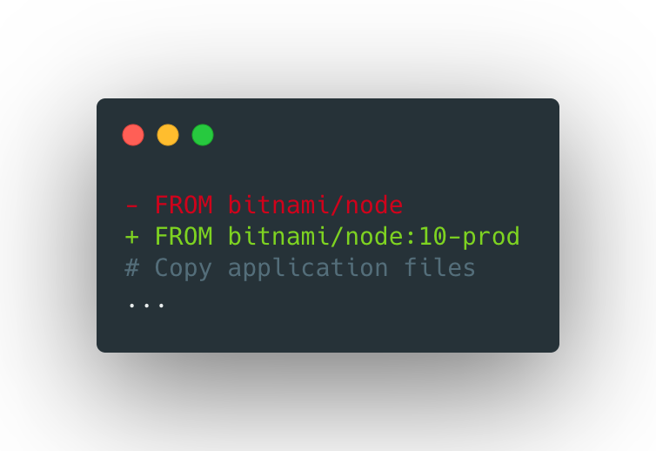
Dockerfile Best Practices
Reuse maintained images when possible (ii)
A real example: Improving a Node.js app Docker image
Use the tag 10-prod to ensure that you are using Node.js 10 with the minimal packages:
Maintained images usually have different tags, used to specify its different flavors.
For instance, the `bitnami/node` image is built for different Node.js versions and it has a `prod` flavor which includes the minimal needed packages to run a Node application (see Supported Tags).
Rebuilding again…
$ docker build . -t express-image:0.0.6 $ docker images --format "{{.Repository}}{{.Tag}} {{.Size}}" express-image0.0.6 251MB
express-image0.0.5 561MB express-image0.0.4 319MB …
Another 68MB!!!

Slide 37
Dockerfile Best Practices
Use multi-stage builds (i)
A real example: Improving a Node.js app Docker image
FROM bitnami/node:10-prod # Copy application files COPY package.json server.js /app/ # Install NPM dependencies RUN npm install --prefix /app EXPOSE 80 CMD ["npm", "start", "--prefix", "app"]
Using the multi-stage builds is a good practice for copying only the artifacts needed in the final image.
The current Dockerfile shows two kind of build steps that we can identify:
Building the application from source code and installing its dependencies.
Running the application.
You can split the build process into different stages keeping the final image as simple as possible.
Current Dockerfile
Multi-stage Dockerfile
FROM bitnami/node:10 AS builder COPY package.json server.js /app/ RUN npm install --prefix /app FROM bitnami/node:10-prod COPY --from=builder /app/package.json /app/server.js /app/ COPY --from=builder /app/node_modules /app/node_modules EXPOSE 80 CMD ["node", "/app/server.js"]
Note: Use AS XXX to label a stage and COPY --from=XXX to copy files from that stage.

Slide 38
Dockerfile Best Practices
Use multi-stage builds (ii)
Another example: Golang app Docker Image
Dockerfile to build Kubeapps Tiller Proxy:
ARG VERSION FROM bitnami/minideb:buster AS builder
RUN install_packages ca-certificates curl git ENV GO_VERSION="1.13.5" \ GOPATH="/go" \ PATH="/usr/local/go/bin:/go/bin:${PATH}" RUN curl https://dl.google.com/go/go${GO_VERSION}.linux-amd64.tar.gz | tar -xzf - -C /usr/local WORKDIR /go/src/github.com/kubeapps/kubeapps RUN git clone --recurse-submodules https://github.com/kubeapps/kubeapps . RUN CGO_ENABLED=0 go build -a -installsuffix cgo -ldflags "-X main.version=v${VERSION}" ./cmd/tiller-proxy FROM scratch COPY --from=builder /etc/ssl/certs/ca-certificates.crt /etc/ssl/certs/ COPY --from=builder /go/src/github.com/kubeapps/kubeapps/tiller-proxy /proxy EXPOSE 80 CMD ["/proxy"]
Using the multi-stage builds is a good practice for copying only the artifacts needed in the final image.
Multi-stage builds are extremely effective when building images for compiled applications.
Let’s see an example using Kubeapps Tiller Proxy, one of the core components of Kubeapps.
ARG VERSION FROM bitnami/minideb:stretch
RUN install_packages ca-certificates curl git ENV GO_VERSION="1.13.5" \ GOPATH="/go" \ PATH="/usr/local/go/bin:/go/bin:${PATH}" RUN curl https://dl.google.com/go/go${GO_VERSION}.linux-amd64.tar.gz | tar -xzf - -C /usr/local WORKDIR /go/src/github.com/kubeapps/kubeapps RUN git clone --recurse-submodules https://github.com/kubeapps/kubeapps . RUN CGO_ENABLED=0 go build -a -installsuffix cgo -ldflags "-X main.version=v${VERSION}" ./cmd/tiller-proxy EXPOSE 80 CMD ["/tiller-proxy"]
Note: Use ARG and --build-arg K=V to modify your builds from the command line.

Slide 39
Dockerfile Best Practices
Use multi-stage builds (iii)
Another example: Golang app Docker Image
Let’s build both images and see the differences:
Using the multi-stage builds is a good practice for copying only the artifacts needed in the final image.
Multi-stage builds are extremely effective when building images for compiled applications.
Let’s see an example using Kubeapps Tiller Proxy, one of the core components of Kubeapps.
$ docker build -f Dockerfile.singlestage -t tiller-proxy-example:single-stage --build-arg VERSION=1.7.2 . $ docker build -f Dockerfile.multistage -t tiller-proxy-example:multi-stage --build-arg VERSION=1.7.2 . $ docker images --format "{{.Repository}}{{.Tag}} {{.Size}}" tiller-proxy-examplemulti-stage 42.2MB tiller-proxy-examplesingle-stage 959MB
The difference is huge! While the final image is just 42.2MB using the multi-stage approach, the other is 20 times bigger!

Slide 40
Dockerfile Best Practices
Use multi-stage builds (iv)
Another example: Golang app Docker Image
ARG VERSION FROM bitnami/minideb:buster AS builder ... FROM scratch AS target-scratch COPY --from=builder /etc/ssl/certs/ca-certificates.crt /etc/ssl/certs/ COPY --from=builder /go/src/github.com/kubeapps/kubeapps/tiller-proxy /proxy EXPOSE 80 CMD ["/proxy"] FROM bitnami/minideb:buster AS target-debian COPY --from=builder /etc/ssl/certs/ca-certificates.crt /etc/ssl/certs/ COPY --from=builder /go/src/github.com/kubeapps/kubeapps/tiller-proxy /proxy EXPOSE 80 CMD ["/proxy"] FROM oraclelinux:7-slim AS target-oracle COPY --from=builder /etc/ssl/certs/ca-certificates.crt /etc/ssl/certs/ COPY --from=builder /go/src/github.com/kubeapps/kubeapps/tiller-proxy /proxy EXPOSE 80 CMD ["/proxy"]
Pro Tip: reuse the artifacts built on the builder stages to create “platform-specific” images.
$ docker build . -f Dockerfile.multidistro -t tiller-proxy-example:scratch --target target-scratch --build-arg VERSION=1.7.2 $ docker build . -f Dockerfile.multidistro -t tiller-proxy-example:debian --target target-debian --build-arg VERSION=1.7.2 $ docker build . -f Dockerfile.multidistro -t tiller-proxy-example:oracle --target target-oracle --build-arg VERSION=1.7.2

Slide 41
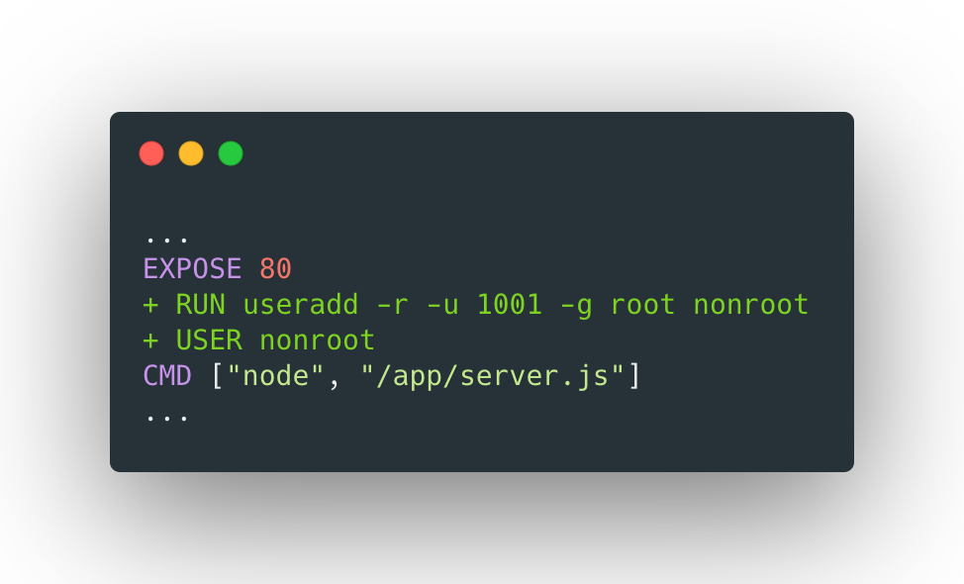
Dockerfile Best Practices
Use non-root approach (i)
A real example: Improving a Node.js app Docker image
Change the default user to “nonroot” to convert you Docker image into a non-root container:
Using the multi-stage builds is a good Running containers as non-root is one of the most popular best practices for security.
It prevents malicious code from gaining permissions in the container host.
It’s a requirement for OpenShift.
Blog posts with detailed information:
Why Non-Root Containers Are Important For Security.
Running Non-Root Containers On Openshift.
Tip: Add the new user to the root group.
Let’s build the container and run it...
$ docker build . -t express-image:0.0.7 $ docker run -p 8080:80 -d --name express-app express-image:0.0.7 $ docker logs express-app events.js:174 throw er; // Unhandled 'error' event ^ Error: listen EACCES: permission denied 0.0.0.0:80

Slide 42
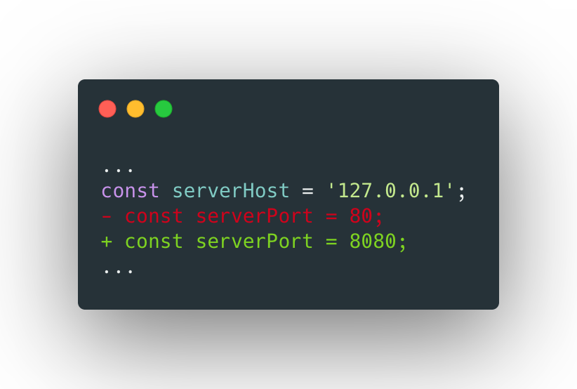
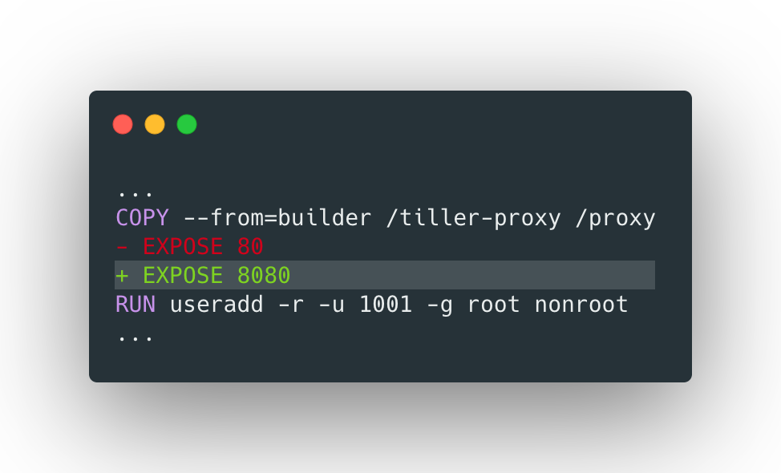
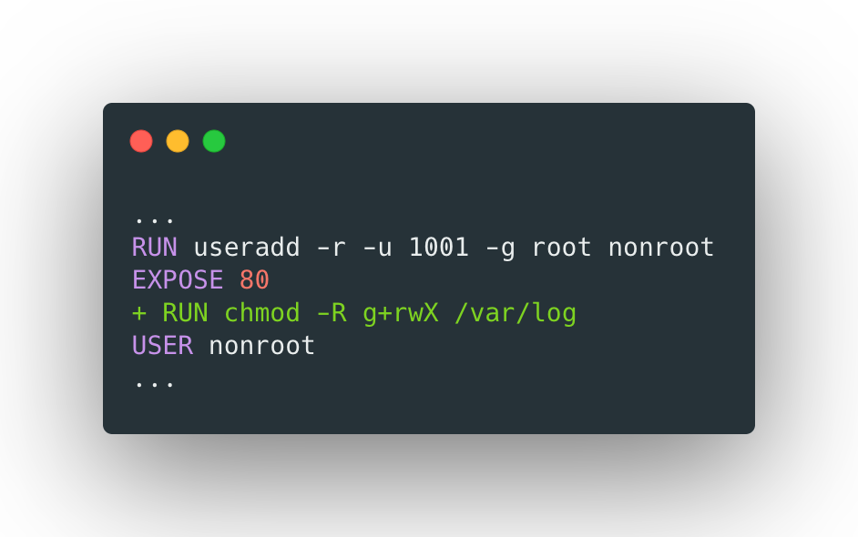
Dockerfile Best Practices
Use non-root approach (ii)
A real example: Improving a Node.js app Docker image
Let’s adapt the app so it uses an alternative port, such as 8080:
There are some details to take into consideration when moving a container to non-root:
File permissions. What directories should be writable by the application? Adapt them by giving writing permissions to the non-root users.
You cannot use privileged (1-1023) ports anymore.
You cannot perform any action that requires privileged permissions for debugging purposes.
The app writes its log at /var/log/app.log.Give permissions to the nonroot user:

Slide 43
Dockerfile Best Practices
Use non-root approach (iii)
A real example: Improving a Node.js app Docker image
Let’s try to rebuild the container and run it again...
There are some details to take into consideration when moving a container to non-root:
File permissions. What directories should be writable by the application? Adapt them by giving writing permissions to the non-root users.
You cannot use privileged (1-1023) ports anymore.
You cannot perform any action that requires privileged permissions for debugging purposes.
$ docker build . -t express-image:0.0.7 $ docker run -p 8080:8080 -d --name express-app express-image:0.0.7 $ curl 'http://127.0.0.1:8080' Hello world $ docker exec express-app whoami nonroot
Now you need to ensure you expose the port 8080.

Slide 44
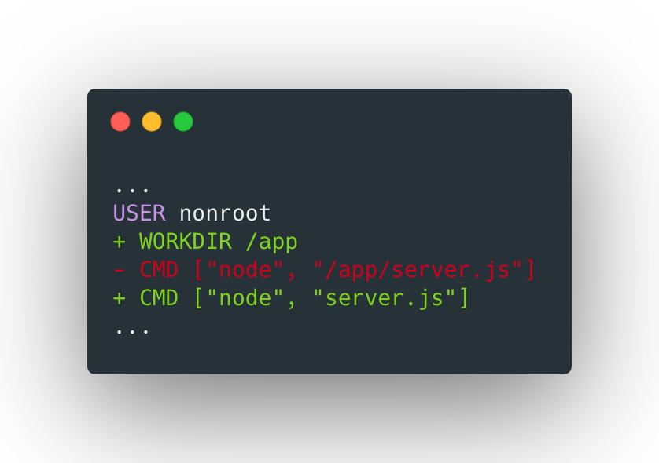
Dockerfile Best Practices
Set the WORKDIR instruction
A real example: Improving a Node.js app Docker image
Our app code is under the directory /app. Therefore, it makes sense to adapt the working directory to it:
The default value for the working directory is /.
However, unless you use FROM scratch images, it is likely set by the base image you are using.
It is a good practice to set the WORKDIR instruction to adapt it to your application characteristics.

Slide 45
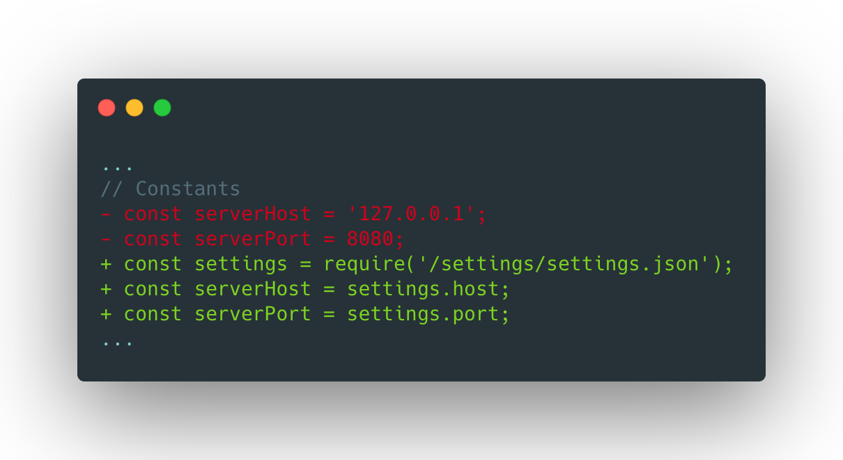
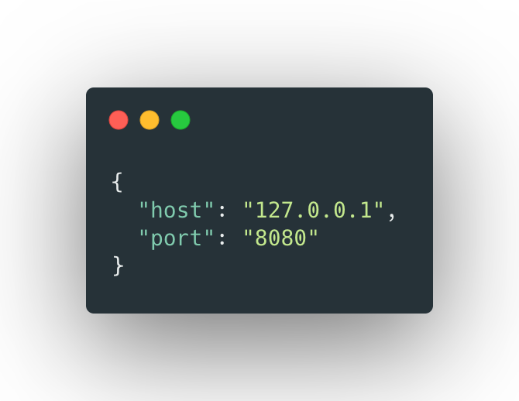
Dockerfile Best Practices
Mount configuration and VOLUME instruction (i)
A real example: Improving a Node.js app Docker image
Let’s adapt our app so the hostname and port are retrieved from a configuration file:
When running your container on Kubernetes, it’s very likely you import your configuration from configMaps or secrets resources that are mounted in the container filesystem as configuration files.
Your app should read its settings from a configuration file.
server.js
settings.json

Slide 46
Dockerfile Best Practices
Mount configuration and VOLUME instruction (i)
A real example: Improving a Node.js app Docker image
Let’s rebuild the image, and mount its configuration settings as shown below:
When running your container on Kubernetes, it’s very likely you import your configuration from configMaps or secrets resources that are mounted in the container filesystem as configuration files.
Your app should read its settings from a configuration file.
$ docker build . -t express-image:0.0.8 $ docker run --rm -d --name express-app \ -v $(pwd)/settings:/settings \ -p 8080:8080 \ express-image:0.0.8 $ curl 'http://127.0.0.1:8080' Hello world

Slide 47
Dockerfile Best Practices
A real example: Improving a Node.js app Docker image
https://github.com/juan131/dockerfile-best-practices/tree/8-mounted-configuration

Slide 48
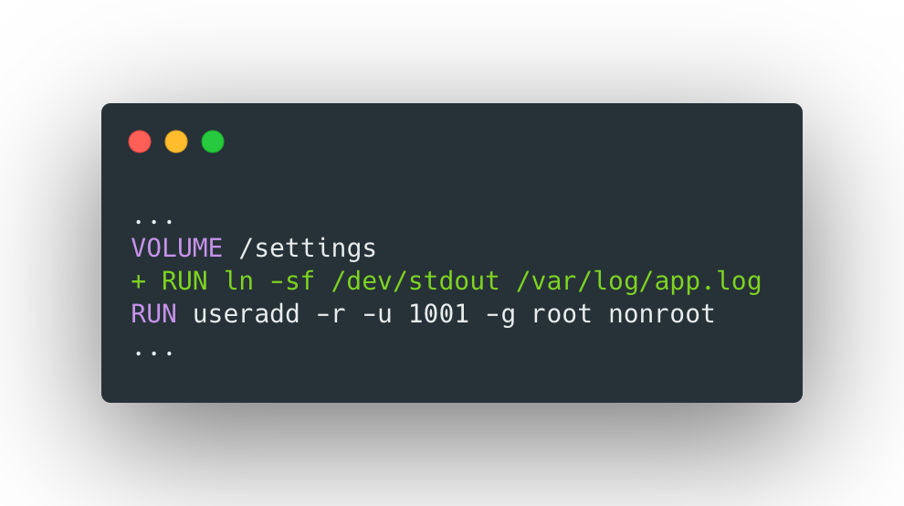
Dockerfile Best Practices
Redirect application logs to stout/stderr
A real example: Improving a Node.js app Docker image
Our app writes its log at /var/log/app.log, you can redirect the logs to stdout using the workaround below:
The applications should redirect their logs to stdout/stderr so they can be collected by the host.
On distributions like K8s, it is very common to have a logging system (such as ELK) that collects logs from every container so they're available for the sysadmins.
Making the logs available to the host is mandatory for these kind of solutions to collect them.
Let’s rebuild the image, and check the logs are being collected by Docker:
$ docker build . -t express-image:0.0.9 $ docker run --rm -d --name express-app -v $(pwd)/settings:/settings -p 8080:8080 express-image:0.0.9 $ docker logs express-app Running on http://127.0.0.1:8080

Slide 49
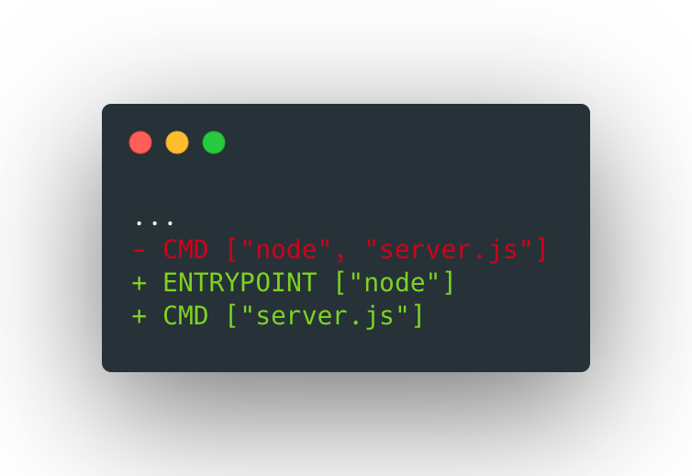
Dockerfile Best Practices
Define an entrypoint
A real example: Improving a Node.js app Docker image
Define an entrypoint:
It is possible to set an entrypoint to act as the main command of the image to make our container more flexible.
Then, we can use the CMD instruction to specify the arguments/flags of the command.
When an application requires to be initialized, you can use a script as your entrypoint. Here you can find an example of the one used on `bitnami/redis` image.
Now the container behaviour depends on the command used to run it. Try running the commands below:
$ docker build . -t express-image:0.0.10 $ docker run --rm express-image:0.0.10 --check server.js $ docker run -v $(pwd)/settings:/settings --rm -p 8080:8080 -d --name express-app express-image:0.0.10
You can always rewrite the entrypoint using the flag --entrypoint:
$ docker run --rm --entrypoint "/bin/ls" express-image:0.0.10 -l /app total 12 drwxr-xr-x 52 root root 4096 Jan 23 16:10 node_modules -rw-r--r-- 1 root root 305 Jan 23 15:31 package.json -rw-r--r-- 1 root root 542 Jan 23 15:54 server.js

Slide 50
A real example
Improving a Node.js app Docker image
End of journey… The initial Dockerfile had the following issues:
It did not make a good use of the build cache
It was packaging too much unnecessary components
It required too much maintenance due to its complexity
It was not secure (running as root)
It did not export any logs to the host so sysadmins could not analyze them
Now we have a much more decent Dockerfile!! But… are we done?

Slide 51




Dockerfile Best Practices
Next steps to become a "pro" building containers
Tests, tests and more tests
Rebuild your containers very frequently
Implement a CI/CD pipeline
Analyze your images

Slide 52
Initializing your apps: Bash Containers

Slide 53
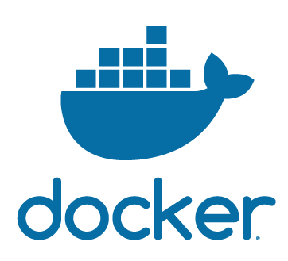



Slide 54





Bash Containers
Specialized cells vs Stem cells
Specialized cells
Stem cells
The same way we have a type of cell for each function in the body…
But we also have stem cells and we can adapt them for each specific function...
We can have a container per asset and purpose (e.g. MariaDB Master container, MariaDB Slave ReadOnly container, etc.)
Let’s do the same for containers! Let’ use a single container (e.g. MariaDB) and let’s provide it the ability to become any kind of MariaDB container.

Slide 55
Bash Containers
When we talked about adding an entrypoint to our containers, we mentioned the possibility of using a script to initialize our apps.
The idea behind Bash containers is using Bash scripts to customize how the assets included on a Docker image are configured during boot time based on:
Environment variables
Mounted configuration files
Existing data from previous deployments

Slide 56
Bash Containers
Use env. variables to
configure your apps
Use env. variables
Let’s take a look to the image below:
You can configure your apps at boot time based on the env. variables set by the user.
As you can check in the Docker documentation, you can use the flag `-e` to pass env. variables when running containers
FROM bitnami/minideb FROM TEXT="Hi bootcampers"
ENTRYPOINT ["/bin/bash", "-c"] CMD ["echo \"${TEXT}\""]
Use the env. variable to modify the message to echo:
$ docker build . -t echo-text $ docker run --rm echo-text Hi bootcampers $ docker run -e "Viva el Betis" --rm echo-text Viva el Betis
Let’s do a small exercise.

Slide 57
Bash Containers
Persisted Data
Persisted data
Let’s take a look to the image below which uses the script, run.sh:
FROM bitnami/minideb COPY run.sh /run.sh
VOLUME /persisted-directory
ENTRYPOINT ["/bin/bash"] CMD [”run.sh"]
#!/bin/bash if [[ -f "cat /persisted-directory/output" ]]; then cat /persisted-directory/output else echo "Initialized" > /persisted-directory/output fi
It’s very common you do some initialization tasks the first time you run a container.
When persisting data, you should avoid the initialization tasks if there’s data from previous deployments
Run the image mounting a volume to persist data:
$ docker build . -t persisted-data $ mkdir data && docker run -v $(pwd)/data:/persisted-directory –rm persisted-data $ docker run -v $(pwd)/data:/persisted-directory --rm persisted-data Initialized!
Let’s do a small exercise.

Slide 58

Bash Containers
Bash Good Practices
Before we move forward, some good practices when writing Bash scripts:
https://github.com/juan131/bash-libraries#bash-best-practices

Slide 59
The Bitnami way

Slide 60
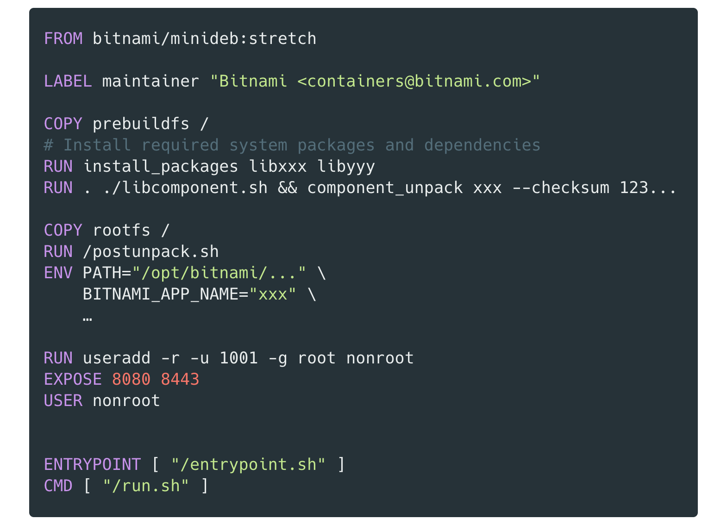
Bash Containers
Dockerfile
Install “custom” packages
Copy initialization/build scripts
Run ‘postunpack.sh’ build script.
Container’s entrypoint
Starts application/server

Slide 61
Bash Containers
Structure
postunpack.sh
entrypoint.sh
setup.sh
run.sh
Mainly used to ensure a series of directories exist and have the proper ownership/permissions configuration.
Every action action that requires ‘root’ privileges should be included here
Container’s entrypoint. It allows to run any desired command using `docker-exec`.
When it’s used to initialize the container, it runs the setup.sh script before run.sh
Configures the server/application so it’s ready to be started. The configuration will be based on the env. variables and files mounted by the user.
Start the corresponding server/application.

Slide 62
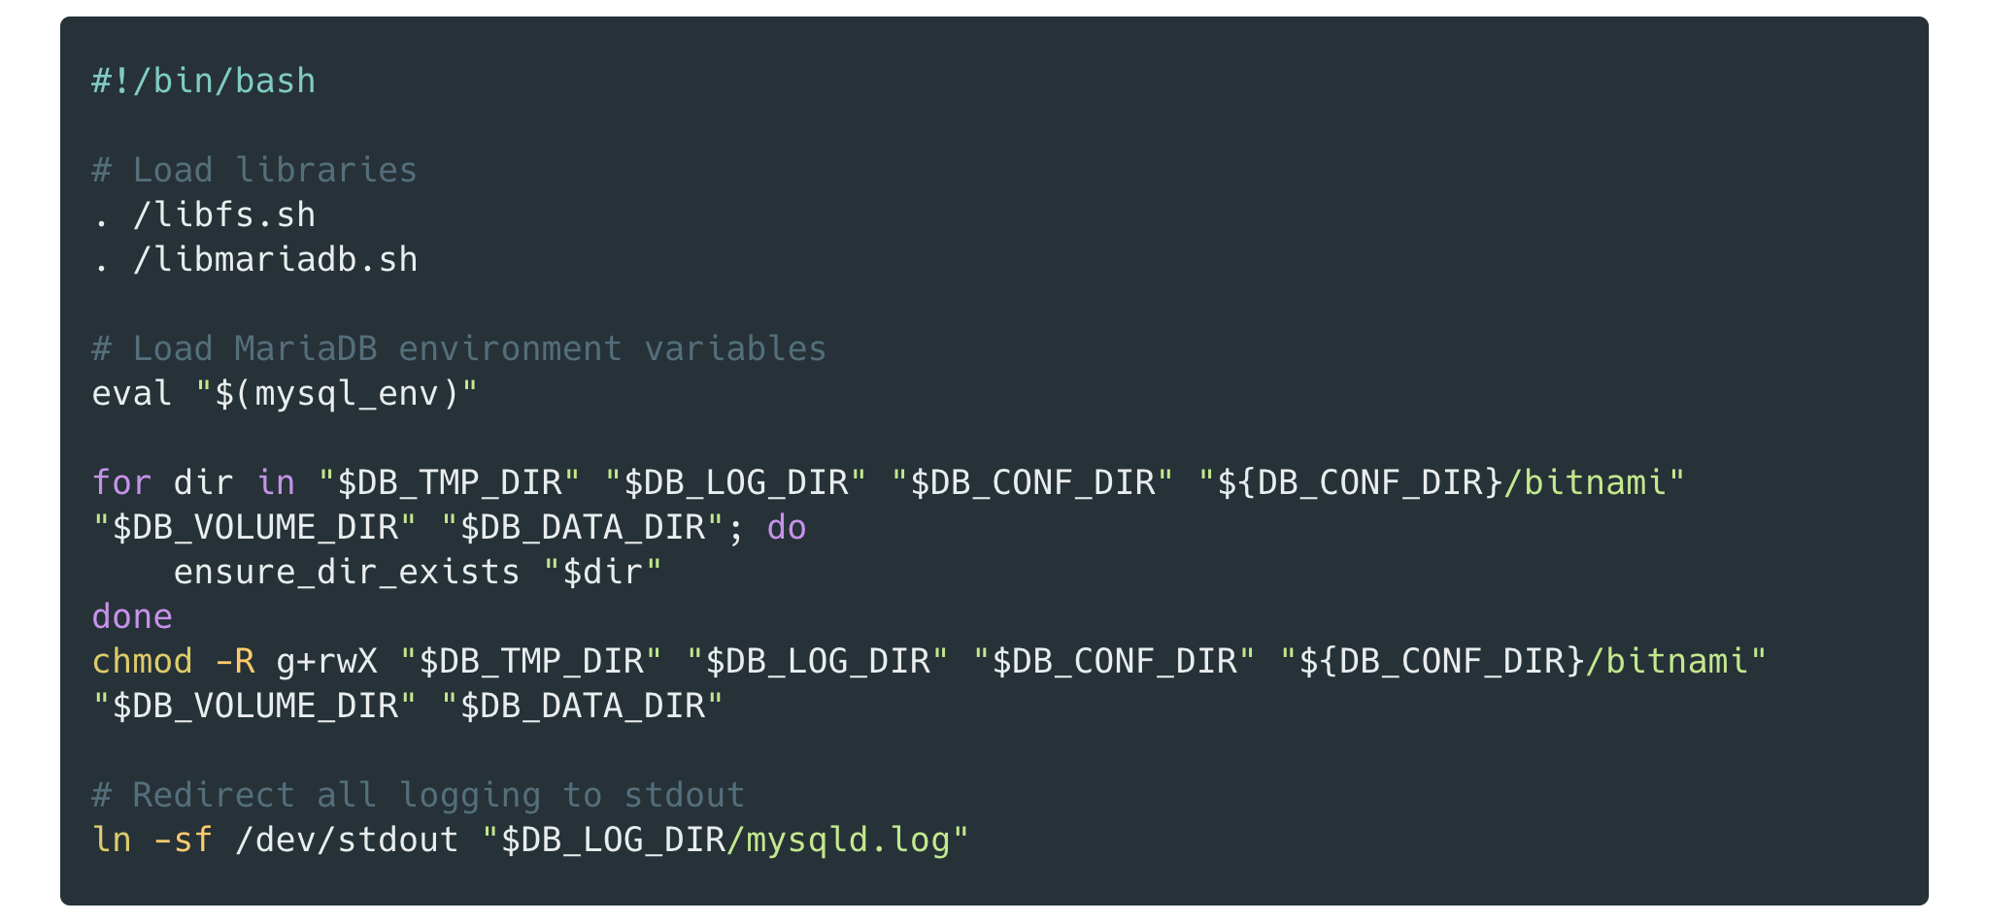
Bash Containers
Structure
Generic libraries
Specific service/app library
Important for to retrieve logs on K8s
postunpack.sh

Slide 63
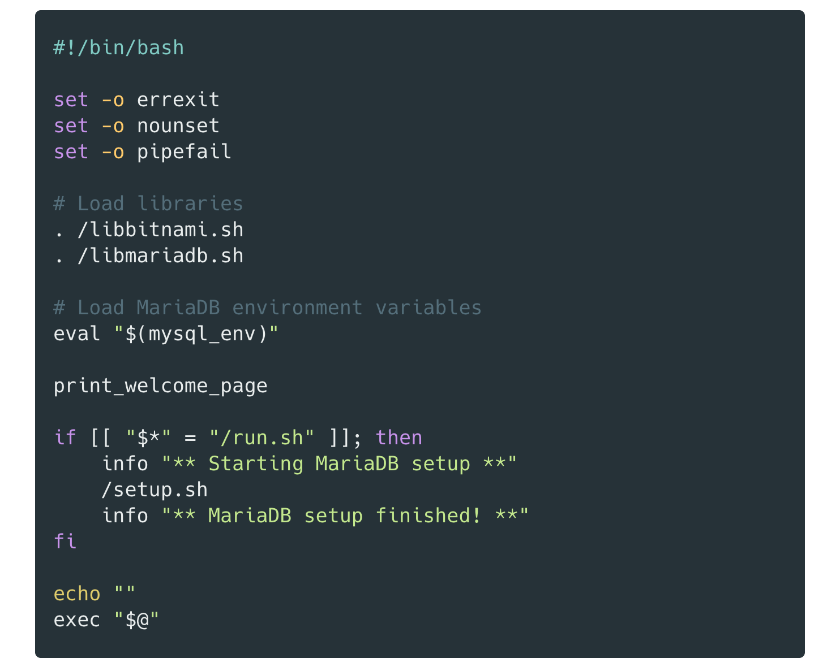
Bash Containers
Structure
entrypoint.sh

Slide 64
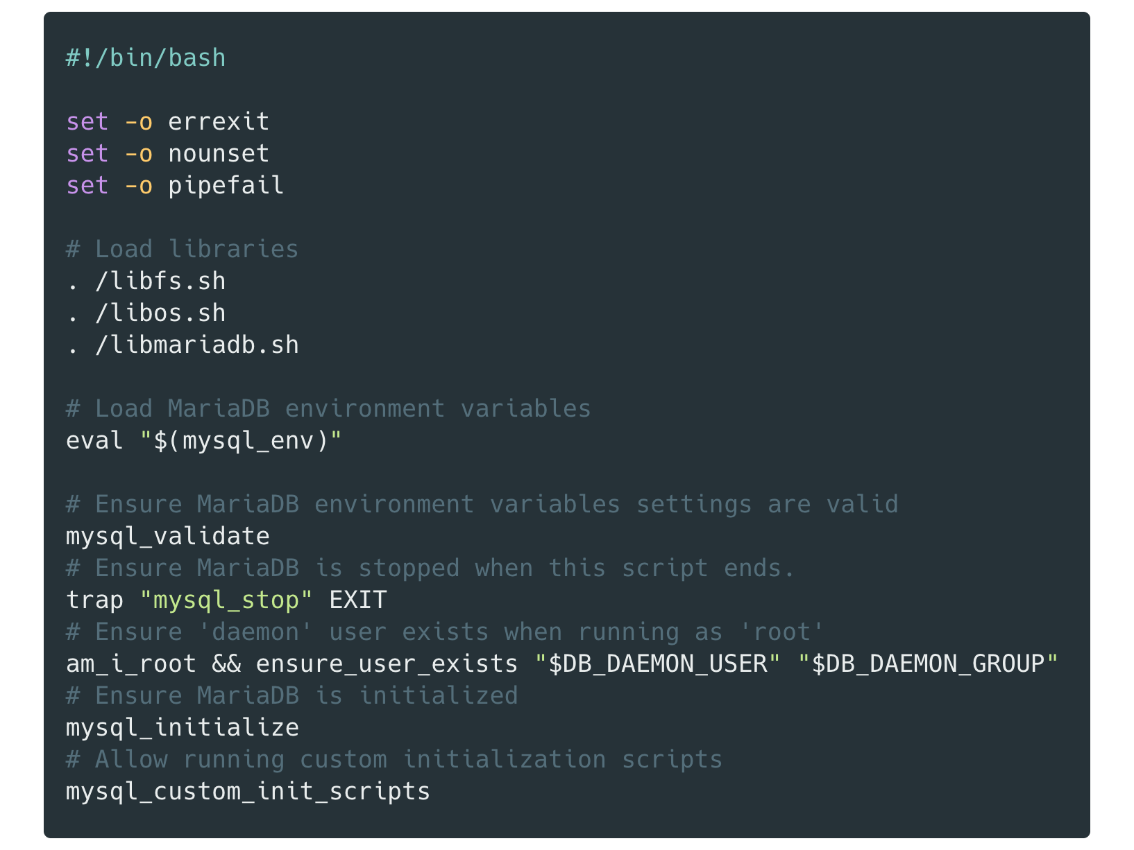
Bash Containers
Structure
Validate env. variables setup
Initialise app/server
Run custom scripts
setup.sh

Slide 65
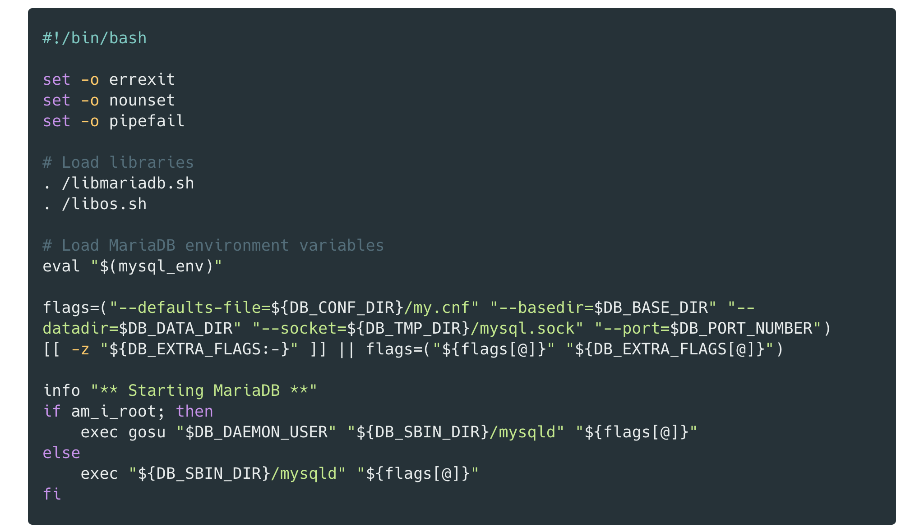
Bash Containers
Structure
User custom flags
run.sh

Slide 66
Exercises

Slide 67
Exercises
Basic CLI Exercises
Using “docker run”
Exercise 1: Find the way to override the entrypoint of an existing image
Exercise 2: Find the way to change the user that will execute the container
Using “docker build”
Exercise 3: Find the way to build an image in a given context, but using a Dockerfile from a different location
Exercise 4: Find the way to ignore the cached layers when building an image
Using “docker-compose”
Exercise 5: Find the way to define in a docker-compose.yml that an image must be built

Slide 68
Deliverables
Deliverable 1: The "forgotten" Dockerfile instructions
There are some Dockerfile instructions that we did not explain
ARG
ONBUILD
STOPSIGNAL
HEALTHCHECK
SHELL
Find and explain examples where these instructions are useful
(NOTE: we DON'T mean an example where ALL OF THEM are used)

Slide 69
Deliverables
Deliverable 2: Multi-stage build
Create a Dockerfile with at least the following stages:
A download/clone source code stage
A build/compile stage
A runtime stage
The resulting Dockerfile should build Hugo from source, generate a static site and serve it using Bitnami Nginx image
Tips:
‘bitnami/minideb’ is a good starting point
You can use `go build –o path/to/hugo/bin` to specify where to create the output binary
You can get a Hugo sample site here if you don’t want to create a new one

Slide 70
Deliverables
Deliverable 3: Hugo/NGINX Bash container
Modify the “runtime” stage of ex. 2 so you create your own ‘bash” NGINX image (instead of using Bitnami one) based on ‘bitnami/minideb’.
Use the “bitnami” approach using the scripts:
postunpack.sh
entrypoint.sh
setup.sh
run.sh
Include (at least) the following customizations:
Change the port to serve the website based on environment variable
Redirect logs to stdout/stderr or log file (default behaviour)
Add a “docker-compose.yml” to orchestrate volumes

Slide 71
Thank You

